Slide 1
BUILDING A WEBSITE FOR BADMINTON FANS
Capstone Project
(BSF-Website)
Group 14
Notes:
Chúng em Xin kính chào Hội đồng cùng khách mời, quí vị phụ huynh và toàn thể các bạn sinh viên có trong khan phòng ngày hôm nay.
Trước khi bắt đầu thuyết trình về đồ án chúng em xin gừi lời cám ơn chân thành đến:
*Thầy Nguyễn Trọng Tài, người đã trực tiếp hướng dẫn và nhiệt tình giúp đỡ chúng em hoàn thành đồ án.
*Trường đại học FPT cùng toàn thể thầy cô đã nhiệt tình giảng dạy chúng em trong suốt thời gian vừa qua.
*Cuối cùng chúng em xin gửi lời cám ơn chân thành đến gia đình và bạn bè những người đã luôn bên cạnh ủng hộ và giúp đỡ chúng em.
Tên chủ đề đồ án của chúng em là Xây dựng website cho những người yêu thích môn cầu lông, Building….Fans.

Slide 2
Supervisor: Mr. Nguyễn Trọng Tài
Members:
Trần Tấn Phát
Nguyễn Duy Thông
Lê Minh Quân (droped out)
Nguyễn Hồng Tuấn
Hồ Quang Hưng (droped out)

Slide 3
OUTLINE
Scenario Problem
Pros & Cons of Current System
Proposed System
Features
Achievement, Disadvantages and Future Plan
Demo
Questions and Answers

Slide 4


Scenario Problem
Badminton Sport Activities can be devided into 2 group:
Playing Activities.
Business Activities.
Badminton Players:
Rent Court.
Join Contest.
Register Course.
…
Badminton Businesspeople:
Manage Stadium.
Sponsor contest.
Open course.
…

Slide 5
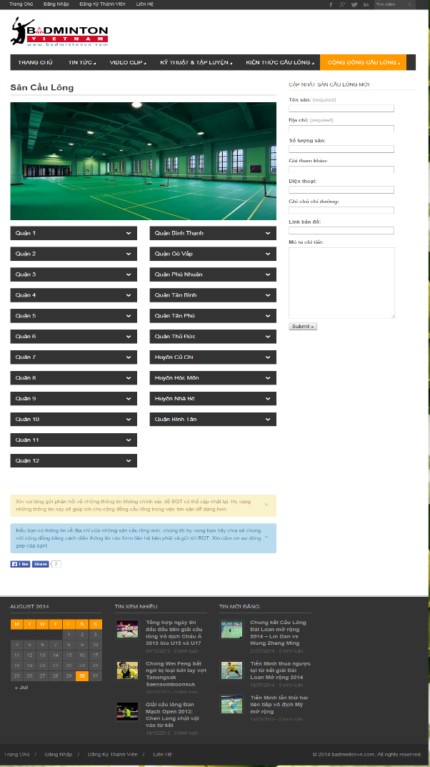
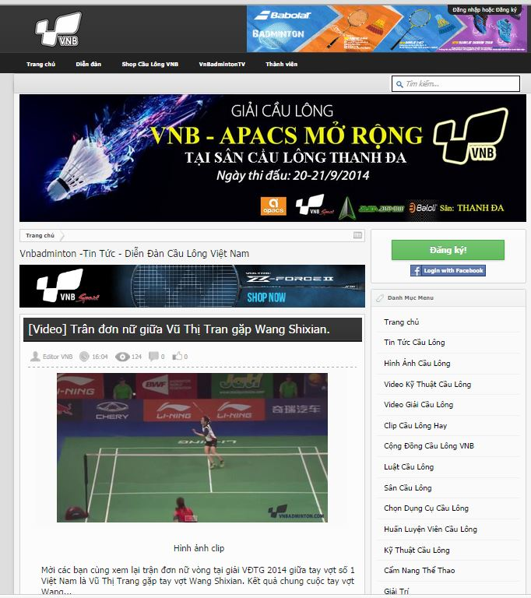
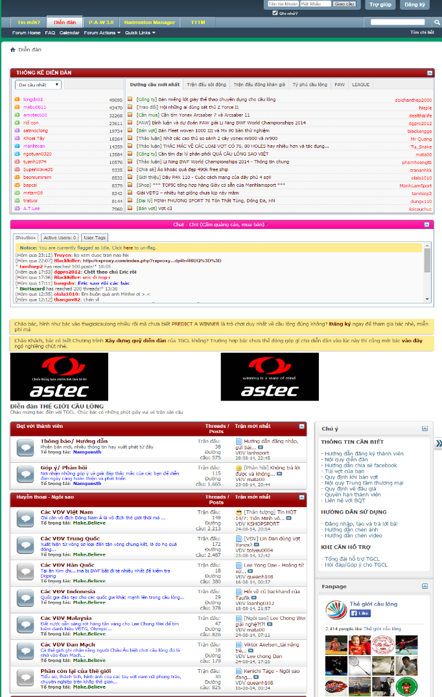
Current Systems
There are some current websites about badminton:
badmintonvn.com
vnbadminton.com
thegioicaulong.com
Notes:
Thêm hình của các website

Slide 6
Advantages | Disadvantages
Not Support Business Management.
Not Organize Course.
Not Online Booking Court.
Not Sponsor Contest
Informative
Crowded People
Notes:
Advantages:
Providing many stadium information.
There are many badminton sport fans.
Disadvantages:
Not supporting badminton business as: sponsoring contests, opening courses, stadium management…
Not supporting for renting court online and online payment.

Slide 7




Propose System
Suggestion, Notification
BSF
Website
Playing Activities
Player
Teaching Activities
Coach
Business Activities
Boss
Manage
Webmaster
Notes:
Badminton Business Utilities.
Badminton Playing activities.
Webmaster Management.
Auto Handling.
Suggestion.
Real time notification.

Slide 8
Technology & Tools
Visual Studio 2012
SQL Server 2008 R2
ASP.NET MVC4
JavaScript
JQuery
Google API
SignalR
Bootstrap

Slide 9





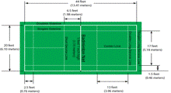

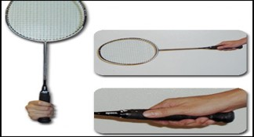

Features
BSF
Website
System Utilities
.
Manage website.
Manage Stadium, Contest, Course.
Course Activities.
Reservation Activities.
Contest Activities.

Slide 10

Flow1. Contest Scenario Demo
Flow2. Stadium Scenario Demo
Flow3. Course Scenario Demo

Slide 11




Flow1. Contest Scenario Demo
Boss Creates Contest.
Boss Arranges Schedule.
Player Joins Contest.
Boss Records Scores and Result.
Boss/ Player view contest statistics.

Slide 12
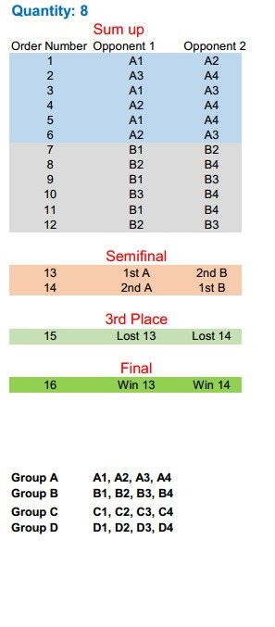
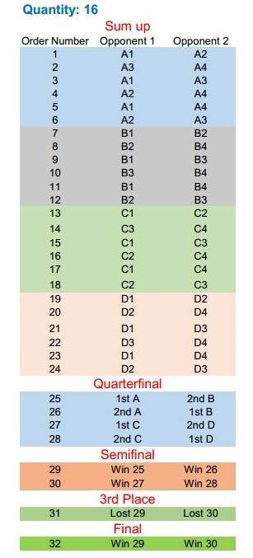
Contest Structure
BSF-Website supports 5 contest types:
Women’s singles
Men’s singles
Women’s doubles
Men’s doubles
Mixed doubles
And 2 types of register quantity:
8 teams or people.
16 teams or people.

Slide 13
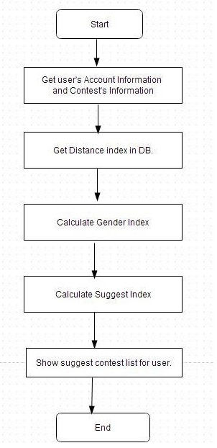
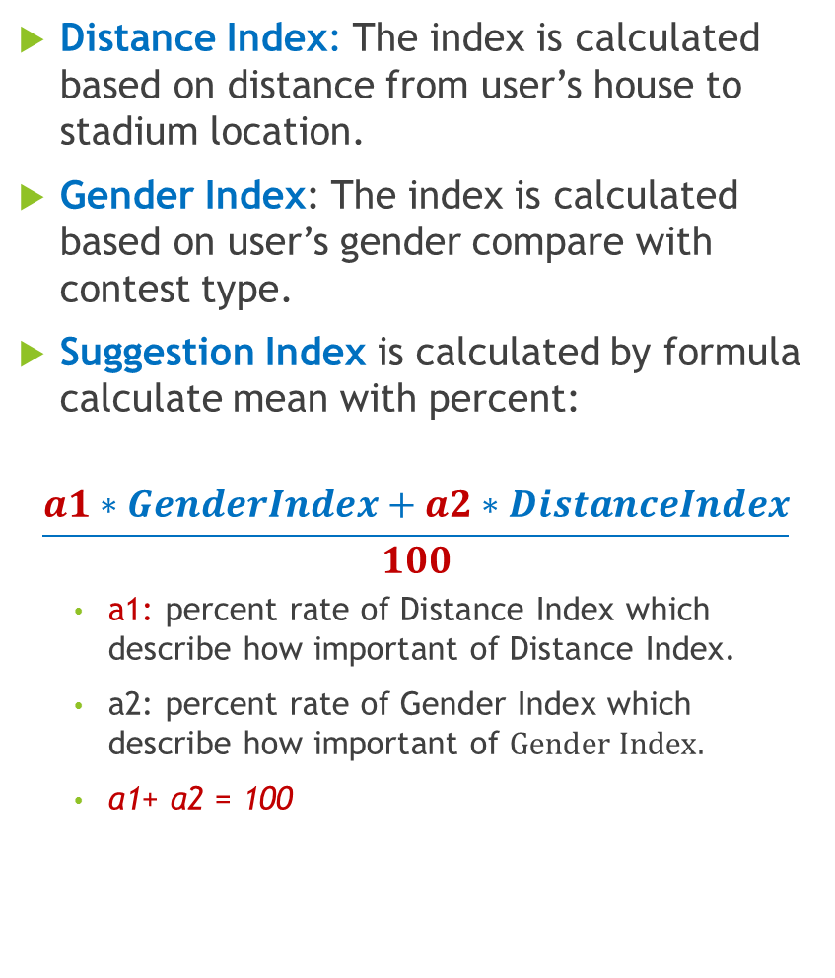
Contest Suggestion
Distance Index: The index is calculated based on distance from user’s house to stadium location.
Gender Index: The index is calculated based on user’s gender compare with contest type.
Suggestion Index is calculated by formula calculate mean with percent:
$$\frac{a1∗GenderIndex+a2∗DistanceIndex}{100}$$
$\text{a}\text{1: }\text{percent} \text{rate} \text{of} \text{Distance} \text{Index} \text{which} \text{describe} \text{how} \text{important} \text{of} \text{Distance} \text{Index}\text{.}$
$\text{a}\text{2: }\text{percent} \text{rate} \text{of} \text{Gender} \text{Index} \text{which} \text{describe} \text{how} \text{important} \text{of} Gender Index.$
$\text{a}\text{1+ }\text{a}\text{2 = 100}$

Slide 14

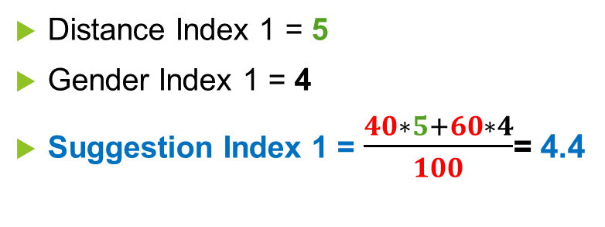
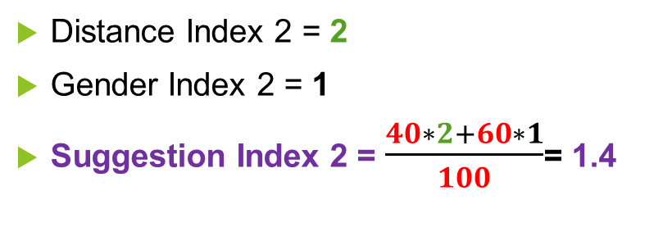
546 Nguyễn Văn Quá, District 12
Example:
2
Contest2. Women’s Singles
1 Song Hành, District 12
1
5
4
Distance Index 2 = 2
Gender Index 2 = 1
Suggestion Index 2 = $\frac{40∗2+60∗1}{100}$= 1.4
Contest1.Men’s Singles
3022 Phạm Thế Hiển, District 8
Distance Index 1 = 5
Gender Index 1 = 4
Suggestion Index 1 = $\frac{40∗5+60∗4}{100}$= 4.4
Suggestion Index 1 > Suggestion Index 2
=>Contest1 will suggested after Contest2
Point
 | 1 | 2 | 3 | 4 | 5
Distance | 0 – 3Km | 3 – 6Km | 6 – 9Km | 9 – 12Km | >12Km
Gender | Single- same gender | Double- same gender | Mixed Doubles | Single- #gender | Double- #gender
Index

Slide 15







Match Schedule Automatic Arrangement
Boss
Process parameters
Input date, time & location parameters
Check constraints & arrange schedule
Boss & Player
Show result
Notes:
Input required location and time parameters.
Process input parameters.
Check constraints and arrange schedule.
Show result.

Slide 16


Flow2. Stadium Scenario Demo
Player Searches Court.
Player Books Court .
Player Pay Money Online.
Player Views Booking History.
Player Choose Stadium.

Slide 17


Flow3. Course Scenario Demo
Boss Creates Course.
Coach Apply Job.
Boss Confirm Application.
Player Changes Course.
Boss Manages Course Members.

Slide 18






Achievements
Easy to use and manage.
Save cost for boss.
Boost business activities.
Save time for users.
Easy deployment.
Less hand work.
Notes:
Easy to use and manage.
Save cost for boss.
Boost business activities.
Save time for users.
Easy deployment.
Less hand work.

Slide 19
Disadvantages
Only online payment by PayPal service.
Only supporting for contest structures with 8 or 16 teams.
Notes:
Only online payment by PayPal service.
Only supporting for contest structures with 8 or 16 teams.

Slide 20




Future Plan
Online payment with more services.
Extend contest structure.
Develop product e-commerce.
Build mobile app.
Notes:
Online payment with more services.
Extend contest structure.
Develop product e-commerce.
Build mobile app.

Slide 21
THANK YOU VERY MUCH!
Questions and Answers

